Slide 1


Data analysis for Geoscience
GEO8026
Dr. Matt Perks

Slide 2


Course Introduction
Part 1: Data processing and analysis with MATLAB
Module delivered over two-weeks
Consisting of five 7-hour blocks:
1-hour lecture, 2-hour practical, 3-hr guided independent study, 1-hour drop-in
Assessment: 2000-word portfolio
Part 2: Statistical methods and graphical techniques with R
Five-week long module consisting of 5hrs/week
Assessment: 2000-word portfolio

Slide 3
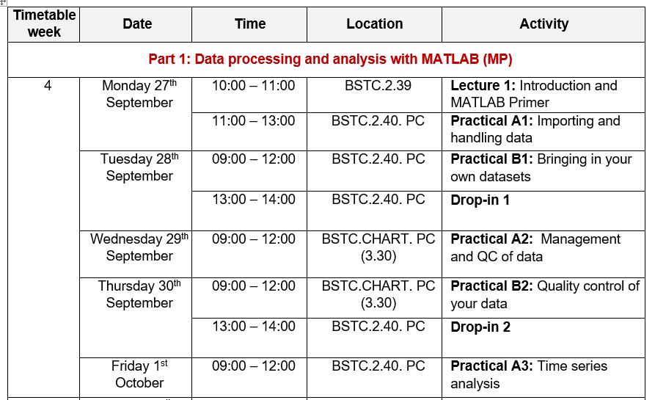
Part 1: Timetable

Slide 4
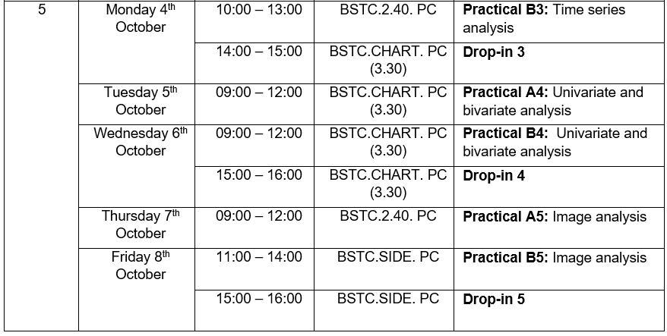
Part 1: Timetable

Slide 5
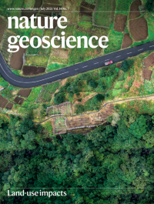









Characteristics of Geoscience Data

Slide 6

What’s your topic(s) of interest?

Slide 7
What data are you planning on using?

Slide 8
What methods are you planning on using?

Slide 9


Code and data management
Generates a backup to the cloud which can be private or public (ensure private for this module)
Avoids having to keep track of multiple versions on your computer e.g. v1, …, v9, etc
All changes to the uploaded files (commits) can be viewed and changes are reversable
Good practice when working within a team environment
Ensure that your data is hosted online to ensure outputs can be reproduced
This should be publicly accessible to ensure the code completes properly
Needs to be shared during submission of portfolio

Slide 10
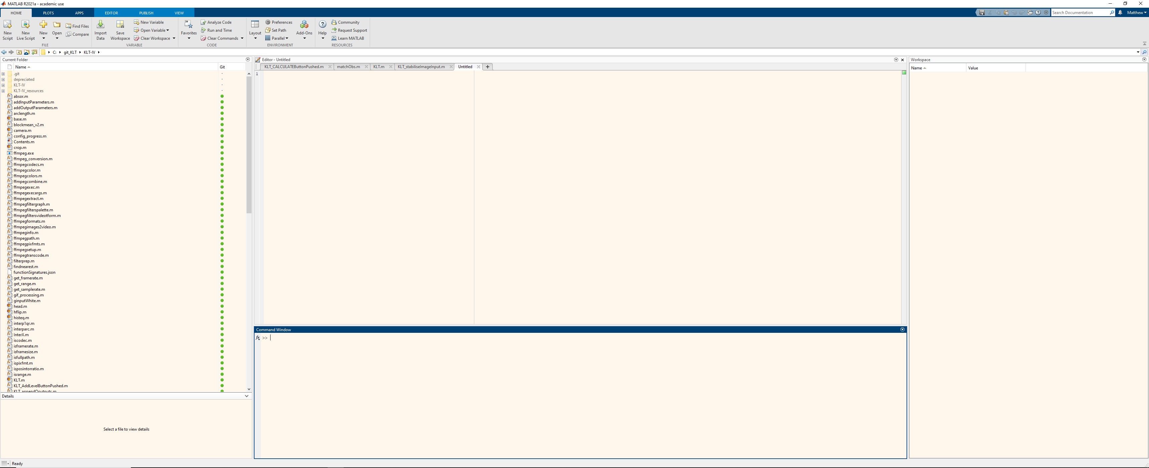
MATLAB primer
Current folder:
Like windows explorer i.e. shows files within the current directory
Editor: scripts, functions, and arrays can be edited
Workspace:
Array and variables are stored here
Command window: basic commands can be executed outside of a script (e.g. a = 1+1)

Slide 11
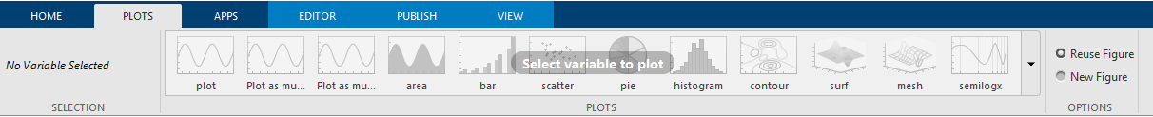
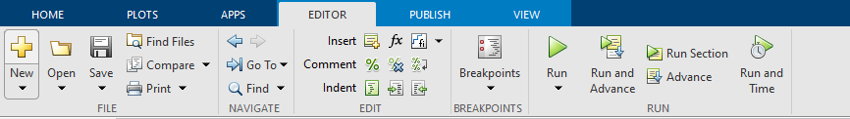
MATLAB primer

Slide 12

Interfacing with folders and directories
Over the course of this module, you will generate several scripts, functions, and use a range of datasets.
Organization of your files and folders is critical.
In order for MATLAB to call a script, function, or access a file, it needs to be visible on the ‘search path’.
To add files and folders to the search path, you can use the addpath function. E.g. :
addpath(genpath('C:\Users\Matt\OneDrive - Newcastle University\GEO8026’));
This will enable MATLAB to call and/or load files within this folder and all subfolders.
Your University OneDrive account is useful for storing your files (5 TB personal storage space)

Slide 13
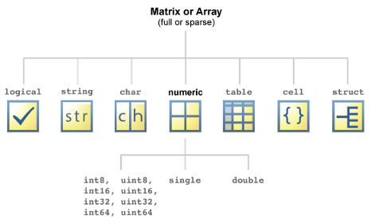
Data types
Logical = Boolean = 0 or 1, false or true
String = collection of characters (letters) e.g.
Character = each letter is treated separately
c = 'apple’; f = c(1) % f = ‘a’
s = "apple"; f = s(1) % f = "apple“
Cell = Treated as non-numeric (but can be numeric)
Numeric = only numbers (and NaN).
Double precision (default, 64 bits) most widely used
Single precision (32 bits)
int8, int16, … = Variables with … bit signed integers
uint8, … = Variables with … bit non-negative integers
Table = mixed input (numeric and string)
Structure = groups related data using data containers called fields
Useful command:
whos
List the variables within the workspace and identifies the data type

Slide 14
Logic & relation operations
Used to assess whether a command meets a requirement
~ NOT: Does not
& AND: used to link expressions
| OR: used to link expressions
&& Short-circuit &: Used on two scalar expressions
|| Short-circuit OR: Used on two scalar expressions
Logic
Used to assess whether a command meets a requirement
== Equal to
~= Not equal to
< Less than
<= Less than or equal to
> More than
>= More than or equal to
Relation

Slide 15
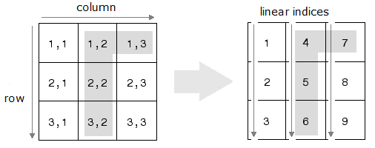
Array indexing
Matrix indexing Linear indexing

Slide 16
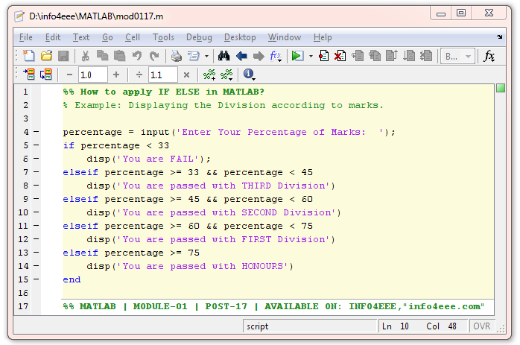
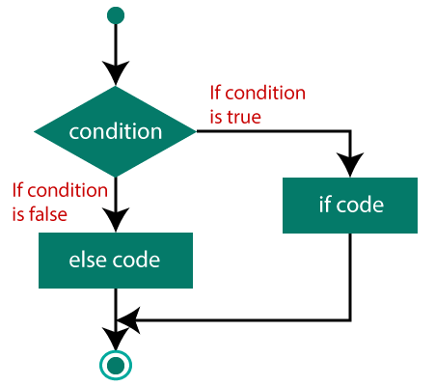
Condition statements

Slide 17
Loops (for and while)
if

Slide 18
Vectorization
Include cellfun

